Slide 1
OPERATING SYSTEMS (CS F372) Deadlocks
Barsha Mitra
CSIS Dept., BITS Pilani, Hyderabad Campus

Slide 2
System Model
System consists of resources
Resource types R₁, R₂, . . ., R_{m}
Each resource type R_{i} has W_{i} instances
Each process utilizes a resource as follows:
request
use
release

Slide 3
Necessary Conditions
Deadlock can arise if four conditions hold simultaneously
Mutual exclusion: only one process at a time can use a resource
Hold and wait: a process holding at least one resource is waiting to acquire additional resources held by other processes
No preemption: a resource can be released only voluntarily by the process holding it, after that process has completed its task
Circular wait: there exists a set {P₀, P₁, …, P_{n}} of waiting processes such that P₀ is waiting for a resource that is held by P₁, P₁ is waiting for a resource that is held by P₂, …, P_{n–1} is waiting for a resource that is held by P_{n}, and P_{n} is waiting for a resource that is held by P₀

Slide 4
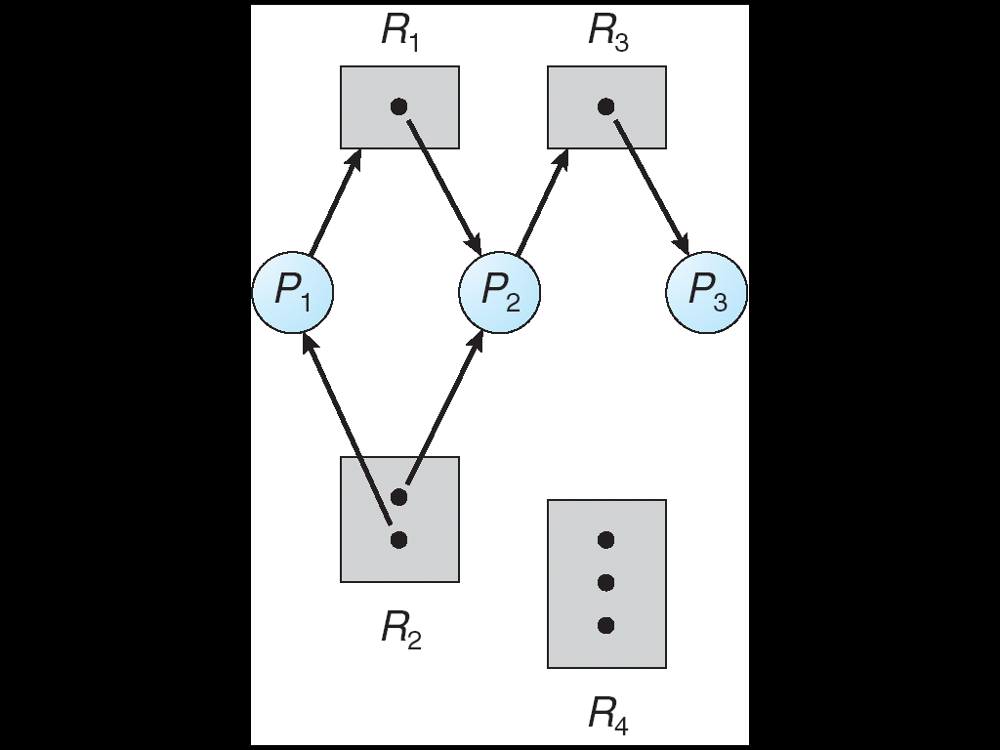
Resource-Allocation Graph
A set of vertices V and a set of edges E
V is partitioned into two types:
P = {P₁, P₂, …, P_{n}}, the set consisting of all the processes in the system
R = {R₁, R₂, …, R_{m}}, the set consisting of all resource types in the system
request edge – directed edge P_{i} → R_{j}
assignment edge – directed edge R_{j} → P_{i}

Slide 5
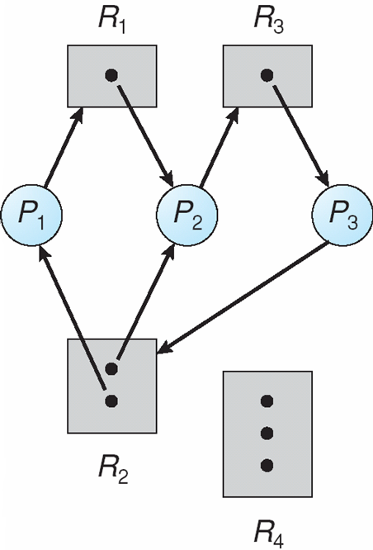
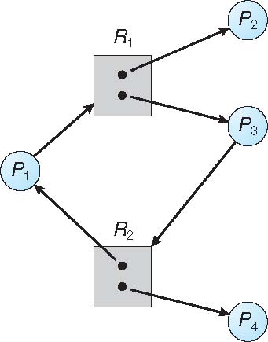
Examples

Slide 6
Inferring Deadlock
If graph contains no cycles ⇒ no deadlock
If graph contains a cycle ⇒
if only one instance per resource type, then deadlock
if several instances per resource type, possibility of deadlock, look for knot
What is KNOT??
A collection of vertices and edges s.t. every vertex in the knot has outgoing edges that terminate at other vertices in the knot
A strongly connected subgraph of a directed graph s.t. starting from any node in the subset it is impossible to leave the knot by following the edges of the graph

Slide 7
Deadlock Handling
Ensure that the system will never enter a deadlock state:
Deadlock prevention
Deadlock avoidance
Allow the system to enter a deadlock state and then recover
Ignore the problem and pretend that deadlocks never occur in the system

Slide 8
Deadlock Prevention
Mutual Exclusion – not required for sharable resources (e.g., read-only files); must hold for non-sharable resources
Hold and Wait – must guarantee that whenever a process requests a resource, it does not hold any other resources
Require process to request and be allocated all its resources before it begins execution
Allow process to request resources only when the process has none allocated to it
Low resource utilization; starvation possible

Slide 9
Deadlock Prevention
No Preemption –
If a process that is holding some resources requests another resource that cannot be immediately allocated to it, then all resources currently being held are released
Preempted resources are added to the list of resources for which the process is waiting
Process will be restarted only when it can regain its old resources, as well as the new ones that it is requesting
When a process P₁ requests some resources and they are allocated to some other waiting process P₂, then preempt the desired resources from P₂ and give them to P₁
If the resources are not allocated to a waiting process, then P₁ must wait
While waiting P₁’s resources may be preempted

Slide 10
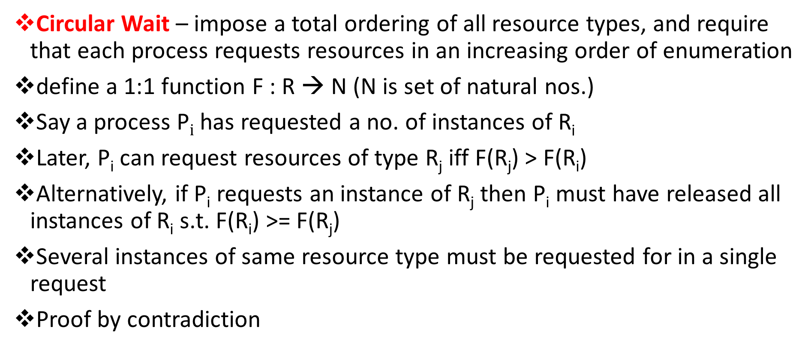
Deadlock Prevention
Circular Wait – impose a total ordering of all resource types, and require that each process requests resources in an increasing order of enumeration
define a 1:1 function F : R → N (N is set of natural nos.)
Say a process P$i$ has requested a no. of instances of R_{i}
Later, P_{i} can request resources of type R_{j} iff F(R_{j}) > F(R_{i})
Alternatively, if P_{i} requests an instance of R_{j} then P_{i} must have released all instances of R_{i} s.t. F(R_{i}) >= F(R_{j})
Several instances of same resource type must be requested for in a single request
Proof by contradiction

Slide 11
Deadlock Avoidance
Requires that the system has some additional a priori information available
Requires that each process declare the maximum number of resources of each type that it may need
Resource-allocation state is defined by the number of available and allocated resources, and the maximum demands of the processes
Deadlock-avoidance algorithm dynamically examines the resource-allocation state to ensure that there can never be a circular-wait condition

Slide 12
Safe State
When a process requests an available resource, system must decide if immediate allocation leaves the system in a safe state
System is in safe state if there exists a sequence <P₁, P₂, …, P_{n}> of ALL the processes in the systems such that for each P_{i}, the resources that P_{i} can still request can be satisfied by currently available resources + resources held by all the P_{j}, with j < i
That is:
If resources needed by P_{i} are not immediately available, then P_{i} can wait until all P_{j} have finished
When P_{j} is finished, P_{i} can obtain needed resources, execute, return allocated resources, and terminate
When P_{i} terminates, P_{i +1} can obtain its needed resources, and so on

Slide 13
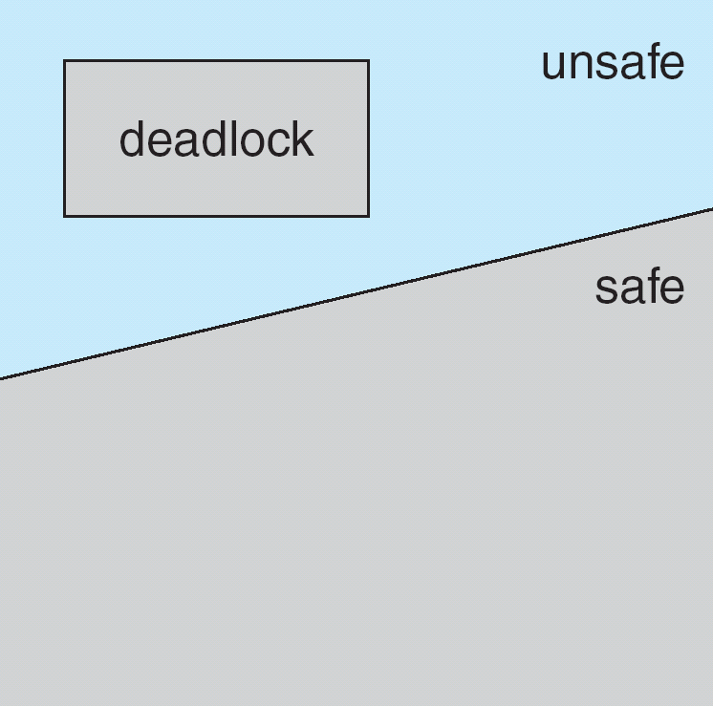
Inferences
If a system is in safe state ⇒ no deadlocks
If a system is in unsafe state ⇒ possibility of deadlock
Avoidance ⇒ ensure that a system will never enter an unsafe state

Slide 14
Avoidance Algorithms
Single instance of a resource type
Use a resource-allocation graph
Multiple instances of a resource type
Use the banker’s algorithm

Slide 15
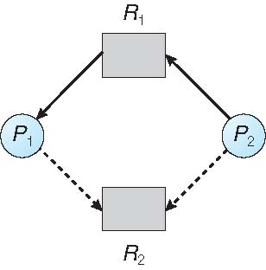
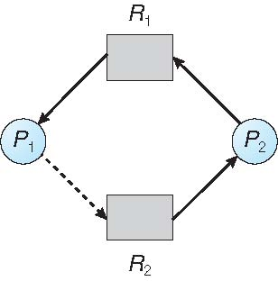
Resource-Allocation-Graph Algorithm
Claim edge P_{i} → R_{j} indicate that process P_{i} may request resource R_{j} in future; represented by a dashed line
Claim edge converts to request edge when a process requests a resource
Request edge converted to an assignment edge when the resource is allocated to the process
When a resource is released by a process, assignment edge reconverts to a claim edge
Resources must be claimed a priori in the system
Request can be granted only if converting the request edge to an assignment edge does not result in the formation of a cycle in the resource allocation graph

Slide 16
Banker’s Algorithm
Multiple instances
Each process must a priori declare maximum use
When a process requests a resource it may have to wait
When a process gets all its resources it must return them in a finite amount of time

Slide 17
Data Structures for Banker’s Algorithm
n = number of processes, and m = number of resources types
Available: Vector of length m. Available [j] = k
Max: n x m matrix. Max [i][j] = k
Allocation: n x m matrix. Allocation[i][j] = k
Need: n x m matrix. Need[i][j] = k
Need [i][j] = Max[i][j] – Allocation [i][j]
Each row of Max, Allocation and Need can be treated as vectors
If X and Y are 2 vectors, then X <= Y iff, X[i] <= Y[i] for all i = 1, 2, ...., n
X < Y

Slide 18
Safety Algorithm
1.Let Work and Finish be vectors of length m and n, respectively.
Initialize: Work = Available, Finish [i] = false for i = 0, 1, …, n - 1
2.Find an i (starting from 0 in each iteration) s.t. both:
(a) Finish [i] == false
(b) Need_{i} ≤ Work
If no such i exists, go to step 4
3.Work = Work + Allocation_{i} Finish[i] = true go to step 2
4.If Finish [i] == true for all i, then the system is in a safe state
O(mn²) operations

Slide 19
Banker’s Algorithm Example
A (10 instances), B (5 instances), and C (7 instances)
Snapshot at time T₀:
< P₁, P₃, P₀, P₂, P₄>
Process | Allocation |  |  | Max |  |  | Available
 | A | B | C | A | B | C | A | B | C
P₀ | 0 | 1 | 0 | 7 | 5 | 3 | 3 | 3 | 2
P₁ | 2 | 0 | 0 | 3 | 2 | 2
P₂ | 3 | 0 | 2 | 9 | 0 | 2
P₃ | 2 | 1 | 1 | 2 | 2 | 2
P₄ | 0 | 0 | 2 | 4 | 3 | 3
Process
P₀
P₁
P₂
P₃
P₄
Need
A | B | C
7 | 4 | 3
1 | 2 | 2
6 | 0 | 0
0 | 1 | 1
4 | 3 | 1

Slide 20
Resource-Request Algorithm
Request_{i} = request vector for process P_{i}. If Request_{i} [j] = k then process P_{i} wants k instances of resource type R_{j}
1. If Request_{i} ≤ Need_{i} go to step 2. Otherwise, raise error condition, since process has exceeded its maximum claim
2. If Request_{i} ≤ Available, go to step 3. Otherwise P_{i} must wait, since resources are not available
3. Pretend to allocate requested resources to P_{i} by modifying the state as follows:
Available = Available – Request_{i} ;
Allocation_{i} = Allocation_{i} + Request_{i};
Need_{i} = Need_{i} – Request_{i} ;
If safe ⇒ the resources are allocated to P_{i}
If unsafe ⇒ P_{i} must wait, and the old resource-allocation state is restored

Slide 21
Banker’s Algorithm Example:
P₁ Requests (1,0,2)
Check that Request₁ ≤ Available (that is, (1,0,2) ≤ (3,3,2) ⇒ true
Process | Allocation |  |  | Max |  |  | Available
 | A | B | C | A | B | C | A | B | C
P₀ | 0 | 1 | 0 | 7 | 5 | 3 | 2 | 3 | 0
P₁ | 3 | 0 | 2 | 3 | 2 | 2
P₂ | 3 | 0 | 2 | 9 | 0 | 2
P₃ | 2 | 1 | 1 | 2 | 2 | 2
P₄ | 0 | 0 | 2 | 4 | 3 | 3
Process
P₀
P₁
P₂
P₃
P₄
Need
A | B | C
7 | 4 | 3
0 | 2 | 0
6 | 0 | 0
0 | 1 | 1
4 | 3 | 1

Slide 22
Deadlock Detection
Allow system to enter deadlock state
Detection algorithm
Recovery scheme

Slide 23
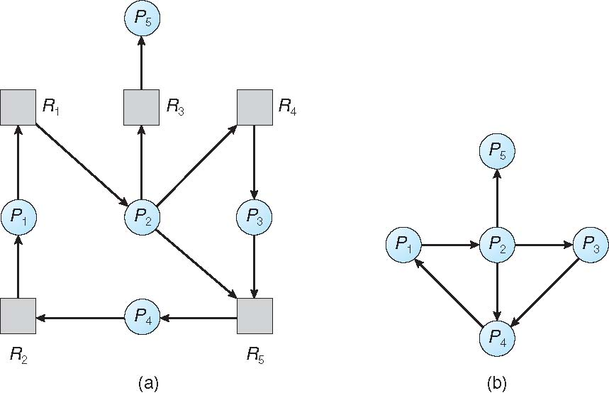
Single Instance of Each Resource Type
Maintain wait-for graph
Nodes are processes
P_{i} → P_{j} if P_{i} is waiting for P_{j}
Periodically invoke an algorithm that searches for a cycle in the graph. If there is a cycle, there exists a deadlock

Slide 24
Recovery from Deadlock:
Process Termination
Abort all deadlocked processes
Abort one process at a time until the deadlock cycle is eliminated
In which order should we choose to abort?
Priority of the process
How long process has computed, and how much longer to completion
Resources the process has used
Resources process needs to complete
How many processes will need to be terminated
Is process interactive or batch?

Slide 25
Recovery from Deadlock:
Resource Preemption
Preempt some resources from processes and give these resources to other processes until the deadlock cycle is broken
Selecting a victim – which resources and which processes, minimize cost by deciding order of preemption
Rollback – return to some safe state, restart process for that state, total rollback or partials
Starvation – same process may always be picked as victim, include number of rollback in cost factor

Slide 26
Thank You

